Slide 1




SMOKER
PREDICTOR
Anjina Ayon Raita

Slide 2

INTRODUCTION
The Smoker Predictor project is a machine learning-powered solution designed to assess the likelihood of an individual being a smoker based on a comprehensive set of health, lifestyle, and demographic parameters. Using a dataset with 25 unique features, the project classifies individuals as smokers or non-smokers by building two prediction models: one utilizing sklearn’s multivariate linear regression and another custom-built from scratch.

Slide 3










WE USED

Slide 4

DATASET
Dataset Overview
Total Samples: 55,691 data samples
Key Features: 27 features, including demographic, health, and clinical data
Objective: Explore the relationship between smoking and various health indicators

Slide 5
DATASET
Dataset Features
Demographic Data:
Gender
Age
Height (cm)
Weight (kg)
Waist(cm)
Health Indicators:
Eyesight (left & right)
Hearing (left & right)
Systolic & Diastolic Blood Pressure (relaxation)
Fasting blood sugar levels
Cholesterol, Triglycerides, HDL, LDL levels
Hemoglobin levels
Urine protein levels
Serum creatinine levels
Liver and Kidney Function:
AST (Aspartate Aminotransferase)
ALT (Alanine Aminotransferase)
GTP (Gamma-Glutamyl Transferase)
Dental Health:
Oral health (presence of dental caries)
Tartar

Slide 6
DATASET
Smoking as the Target Feature
Focus: Investigate how smoking correlates with other health variables
Potential Insights:
Impact on blood pressure (systolic/diastolic)
Relationship with cholesterol, triglycerides, and lipid profile (HDL, LDL)
Effects on liver enzymes (AST, ALT, GTP)
Influence on kidney function (serum creatinine)
Association with oral health (dental caries, tartar)
Connection to physical parameters like weight, height, waist size

Slide 7
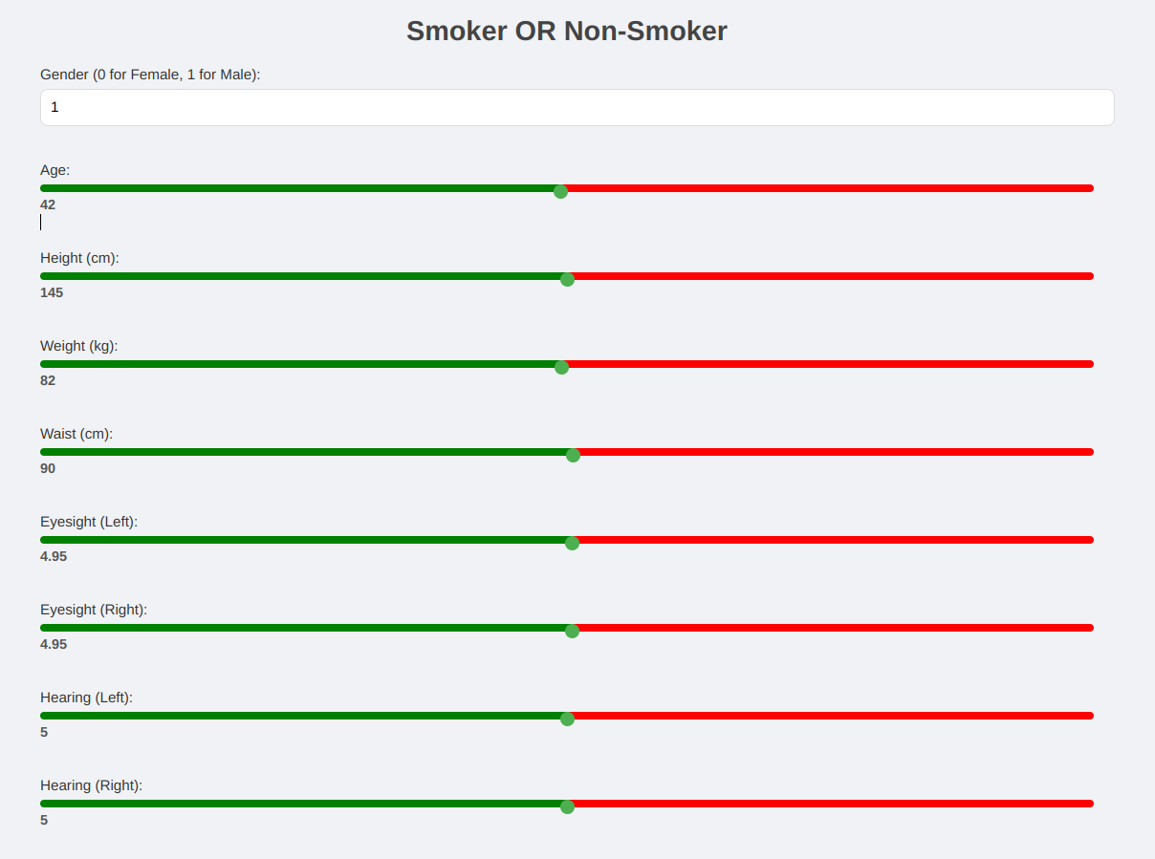
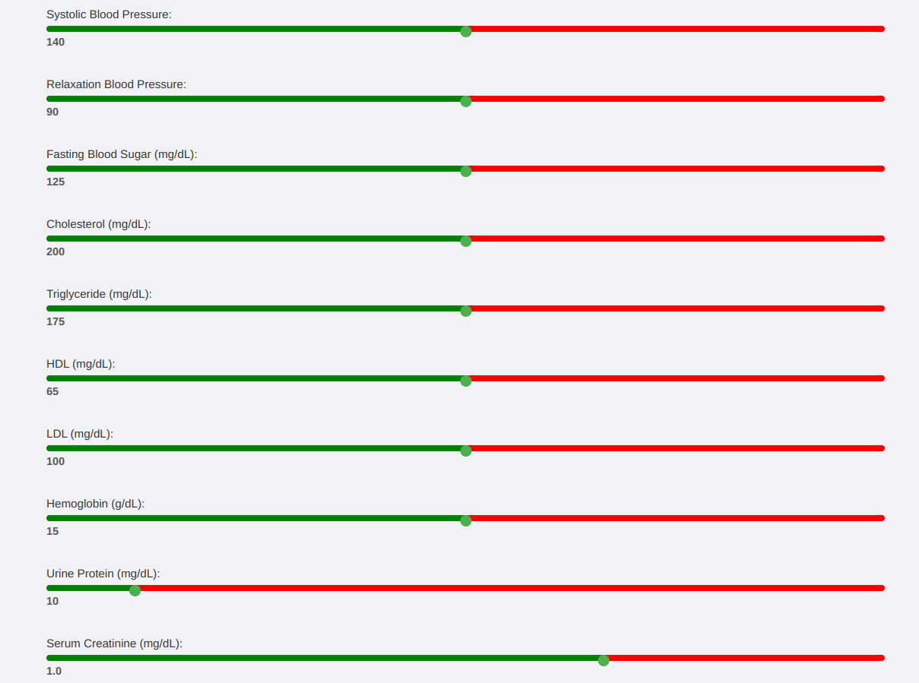
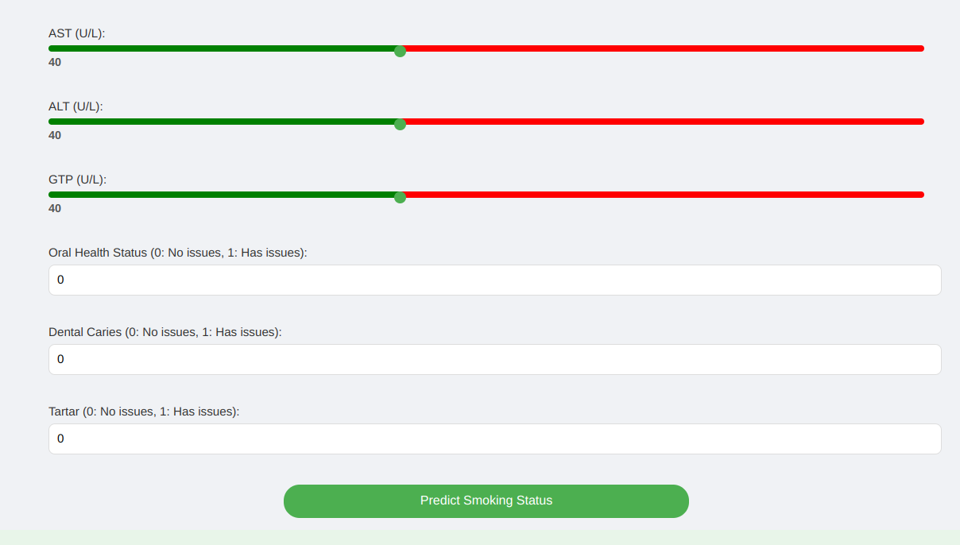
WorkFlow
User Input

Slide 8
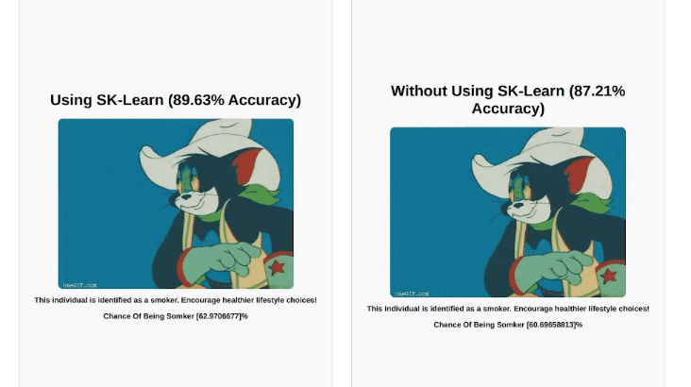
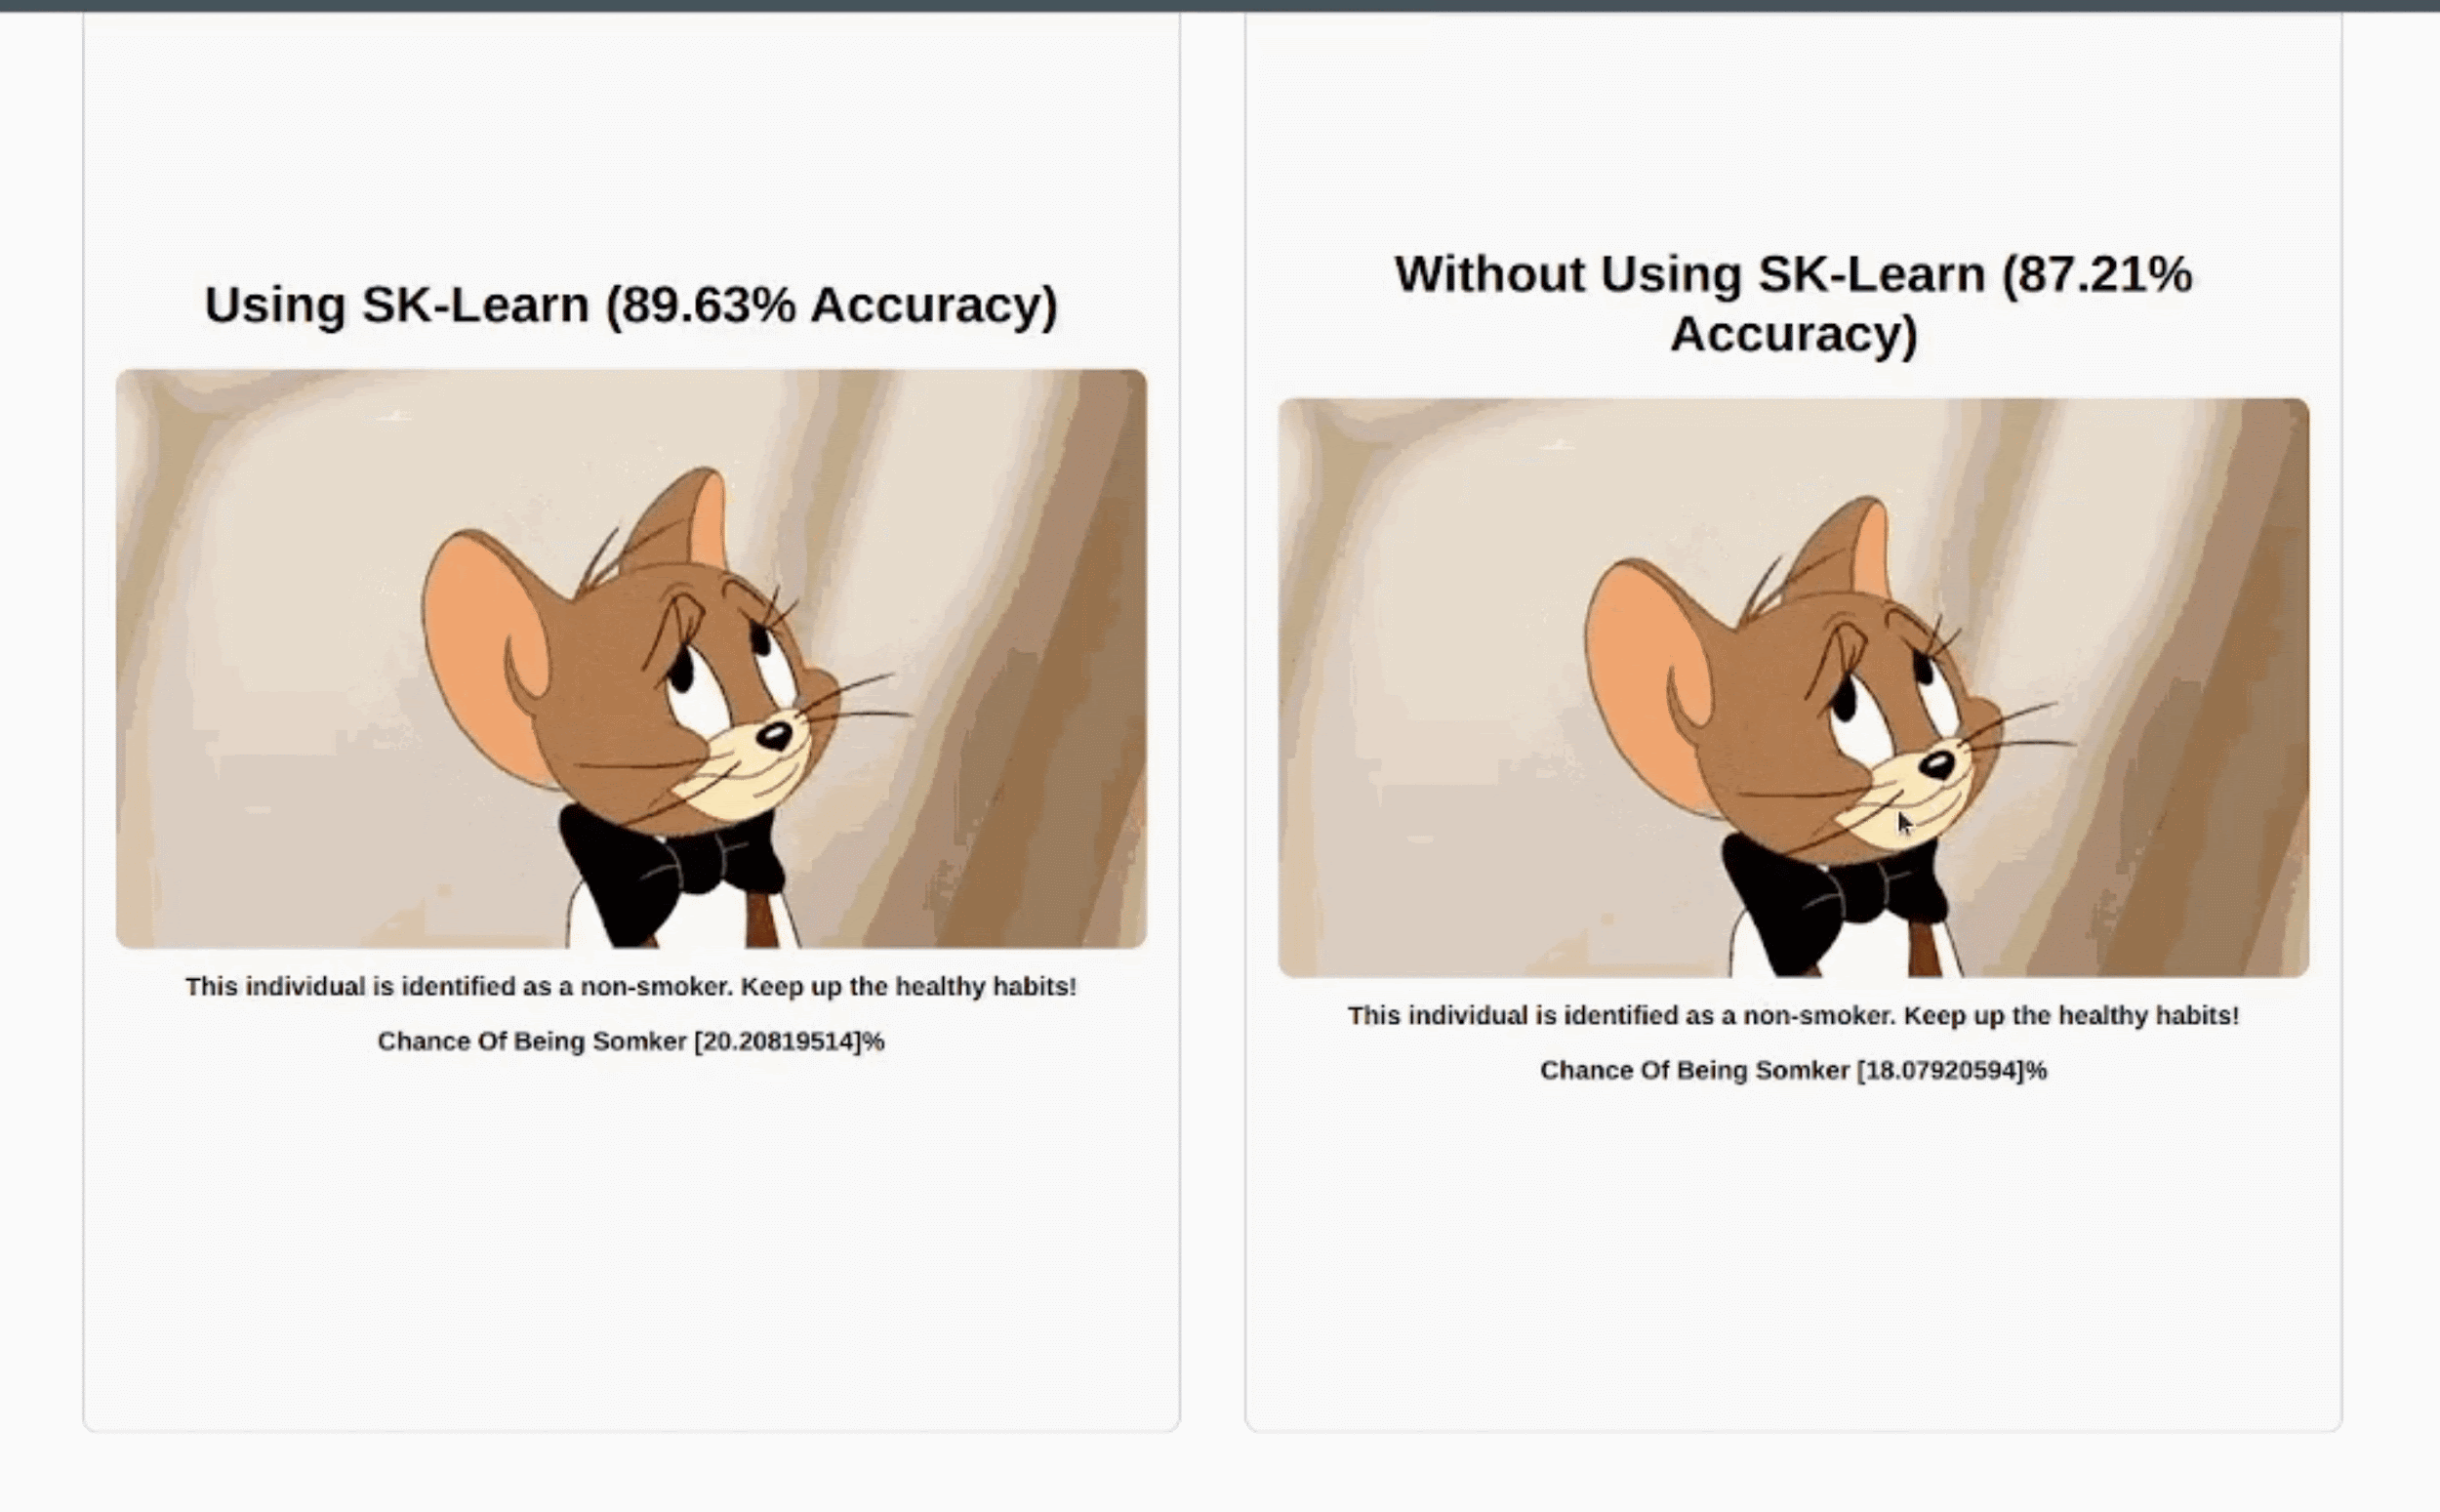
WorkFlow
Model’s Output

Slide 9
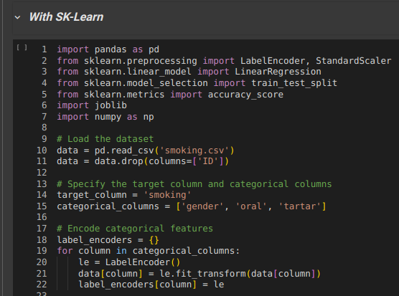
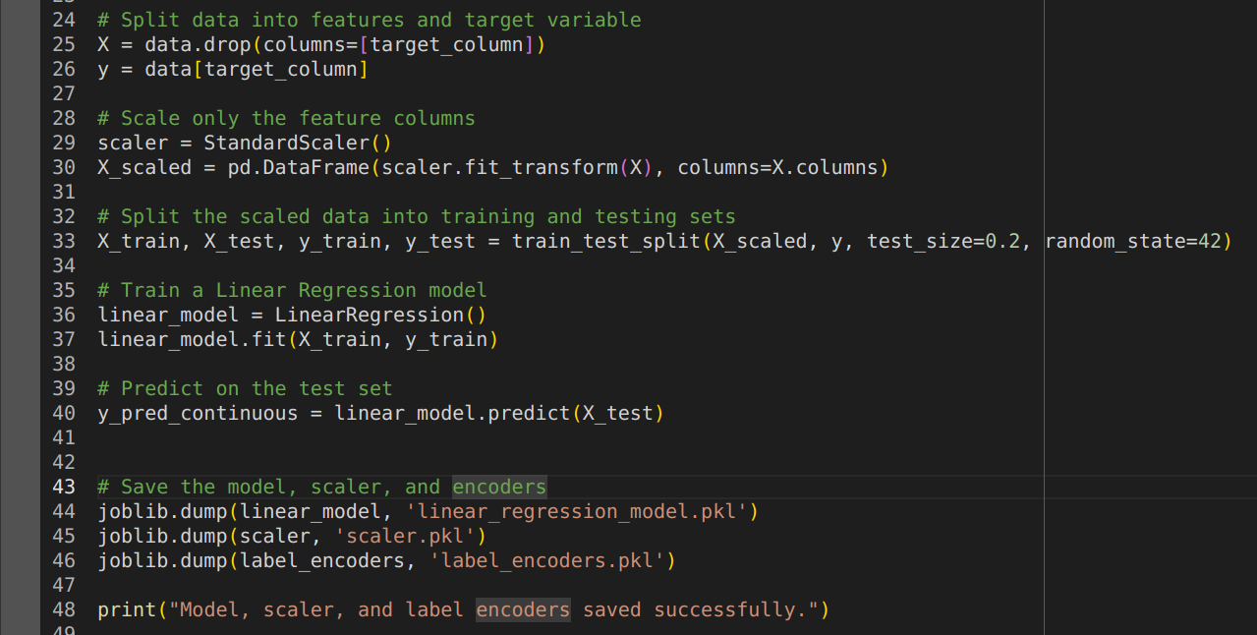
WorkFlow
Model Building -With SK-Learn

Slide 10
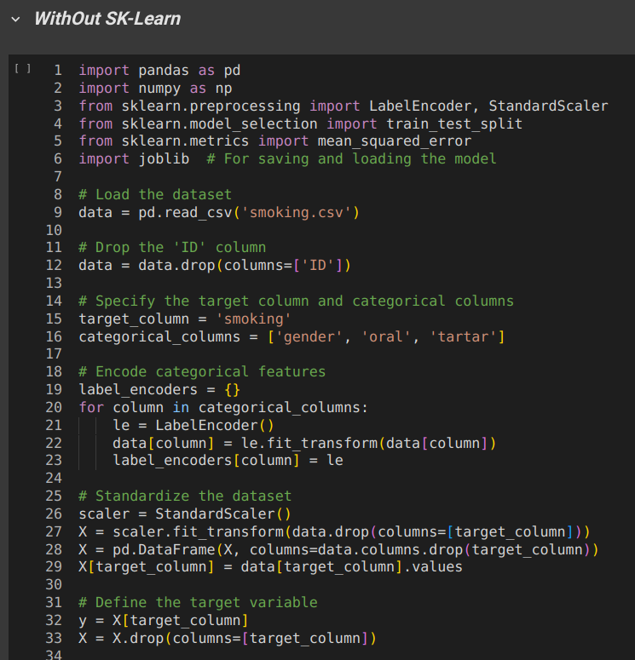
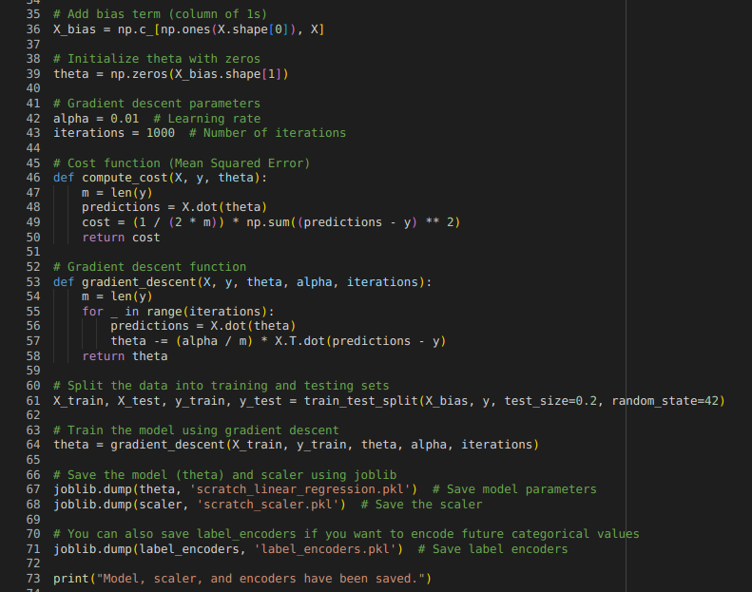
WorkFlow
Model Building -WithOut SK-Learn

Slide 11
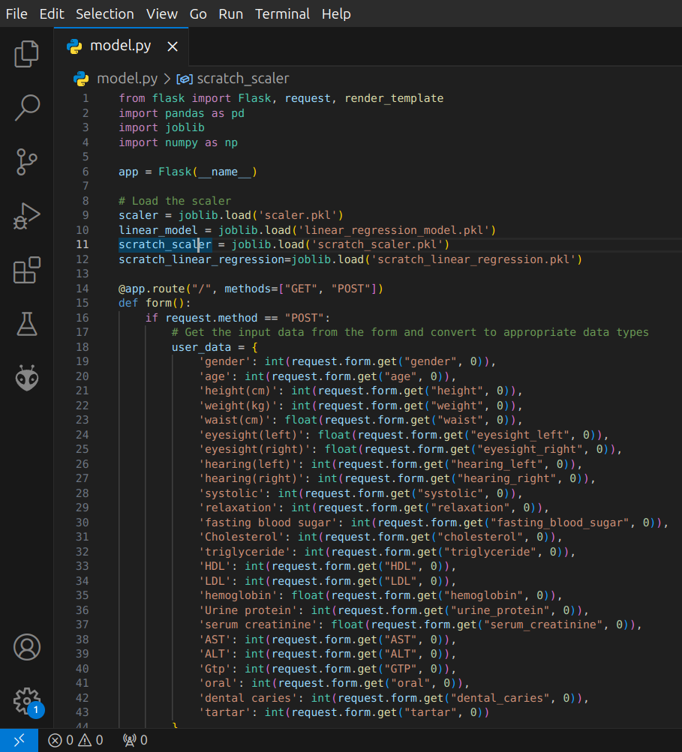
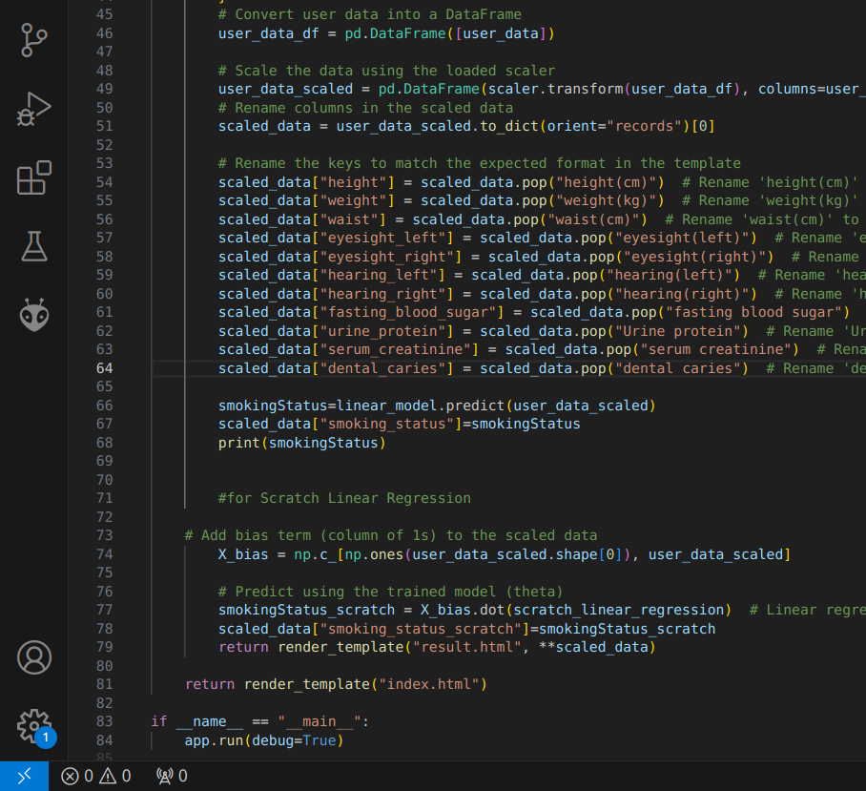
WorkFlow
Using Both Model To Predict

Slide 12
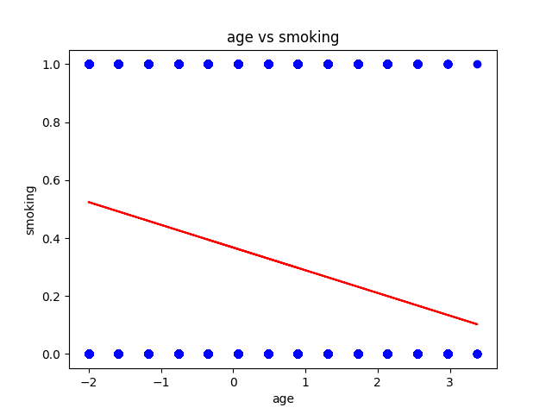
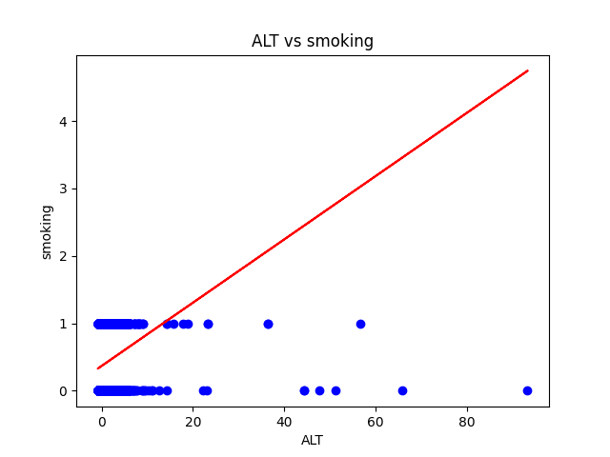
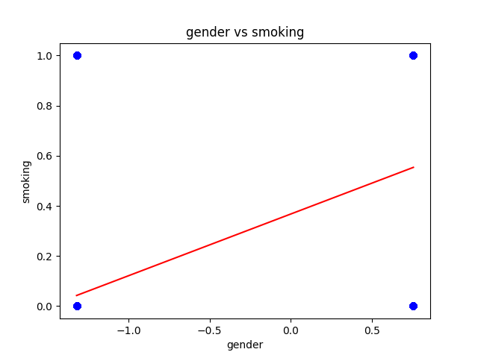
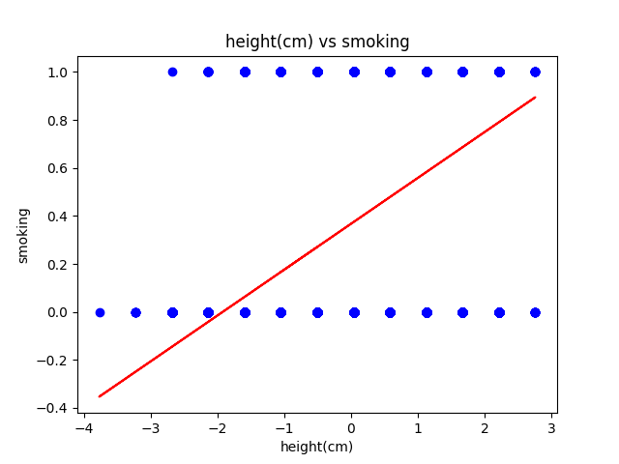
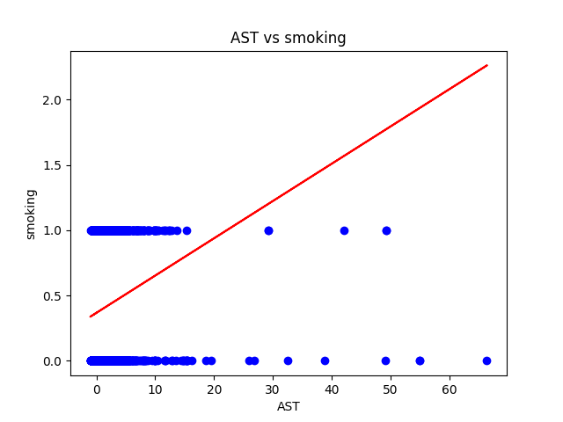
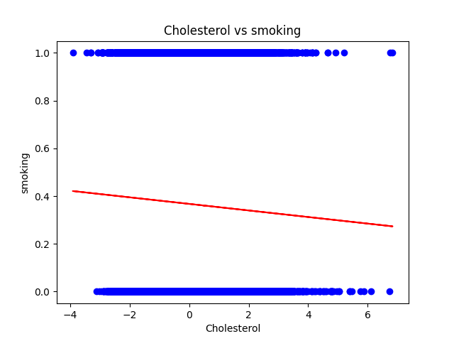
Graphs Comparison

Slide 13
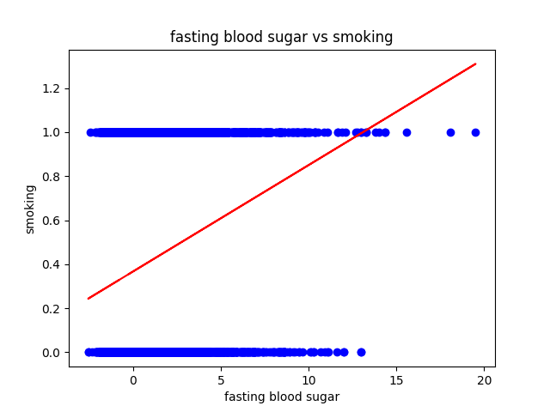
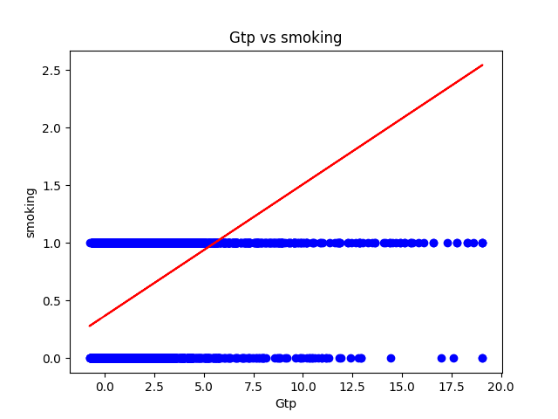
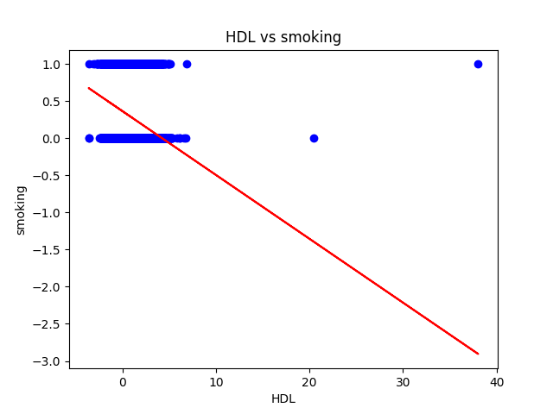
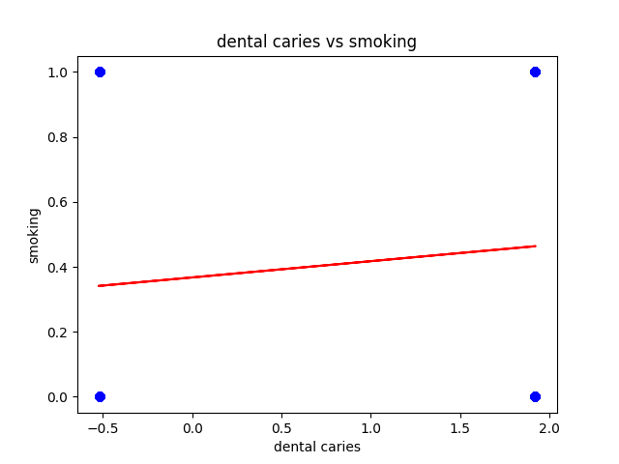
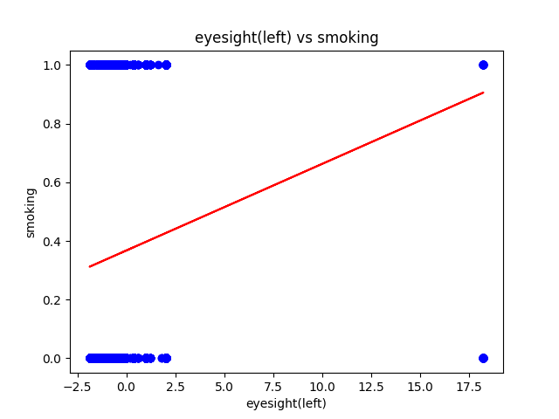
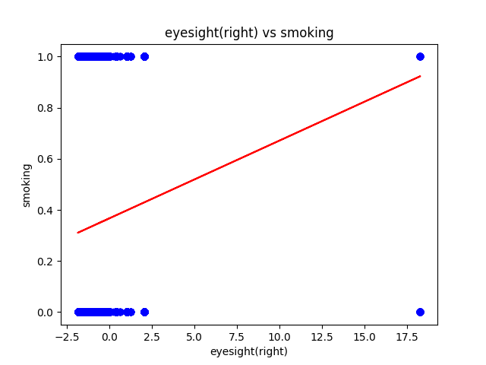
Graphs Comparison

Slide 14
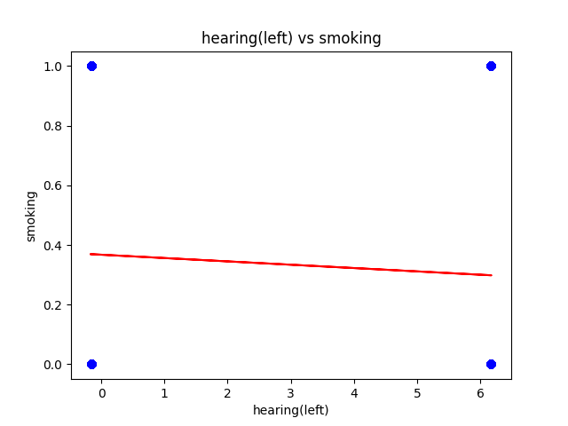
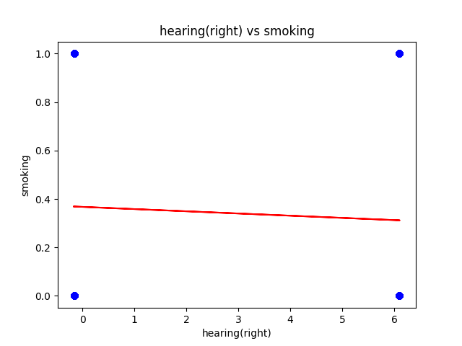
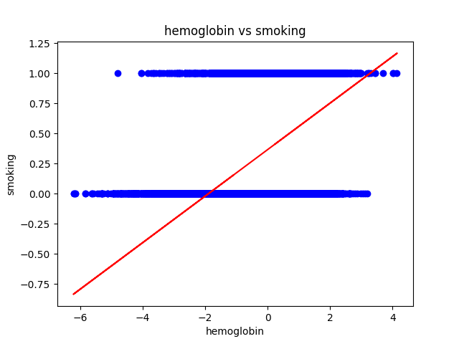
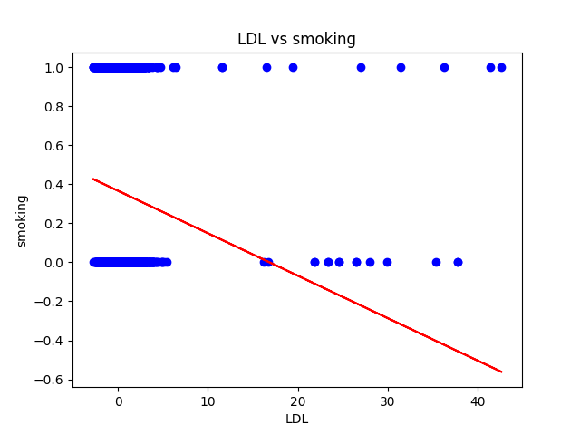
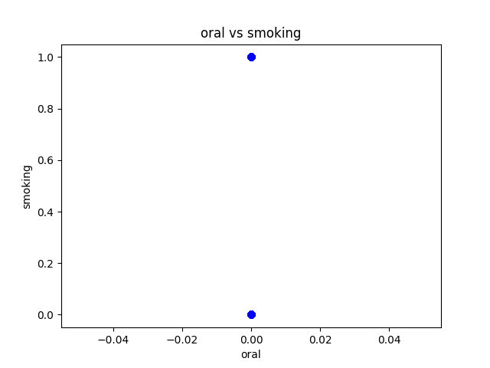
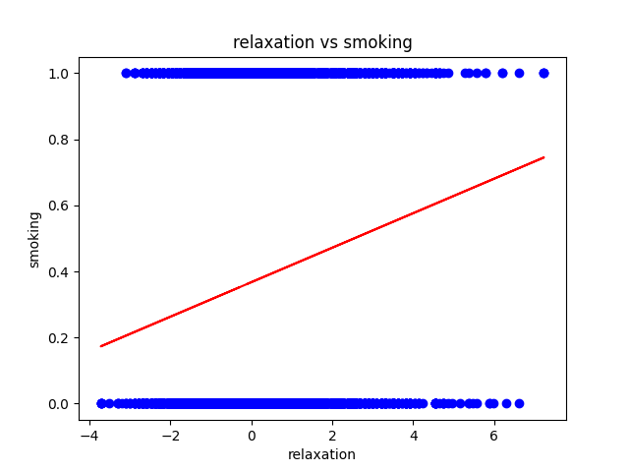
Graphs Comparison

Slide 15
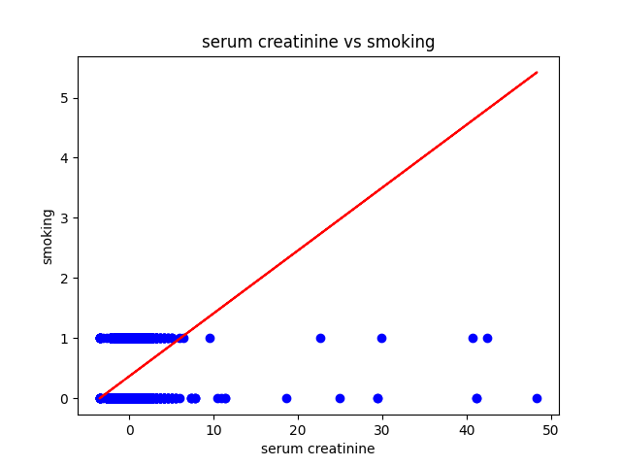
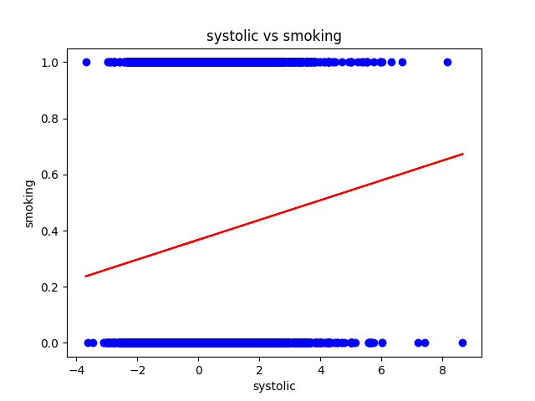
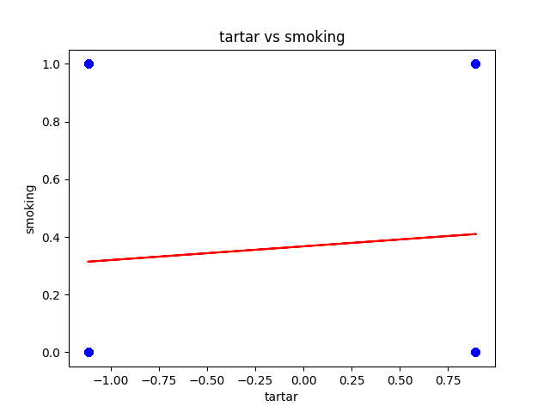
Graphs Comparison

Slide 16
Resources & Demo
GitHub :- Smoker-Perdictor (Presentation Slide, Report & Code)
Live Project : Click Here

Slide 17
THANK YOU

